Slide 1
Sprint Review
Analyzing Facebook Data Using R Packages

Slide 2
Objectives
Sprint Objective
Find R packages that can analyze Facebook data.
Marketing/Business Objective
What is the optimal time for us to post content, i.e. to drive the highest engagement (likes, shares, comments)?

Slide 3
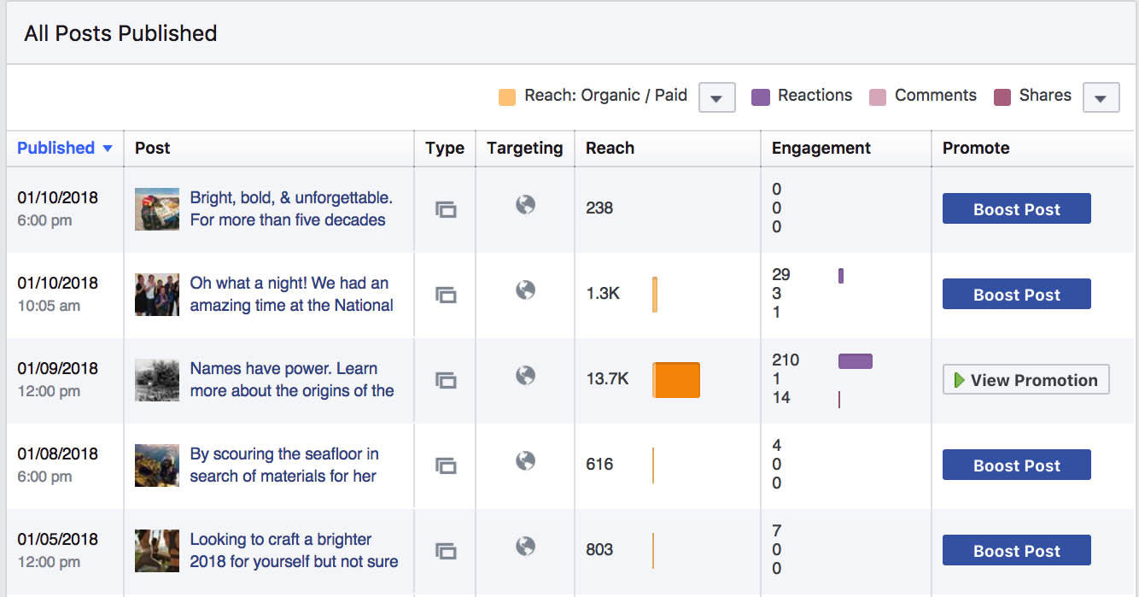
Extracting Facebook Data – The Old Way

Slide 4
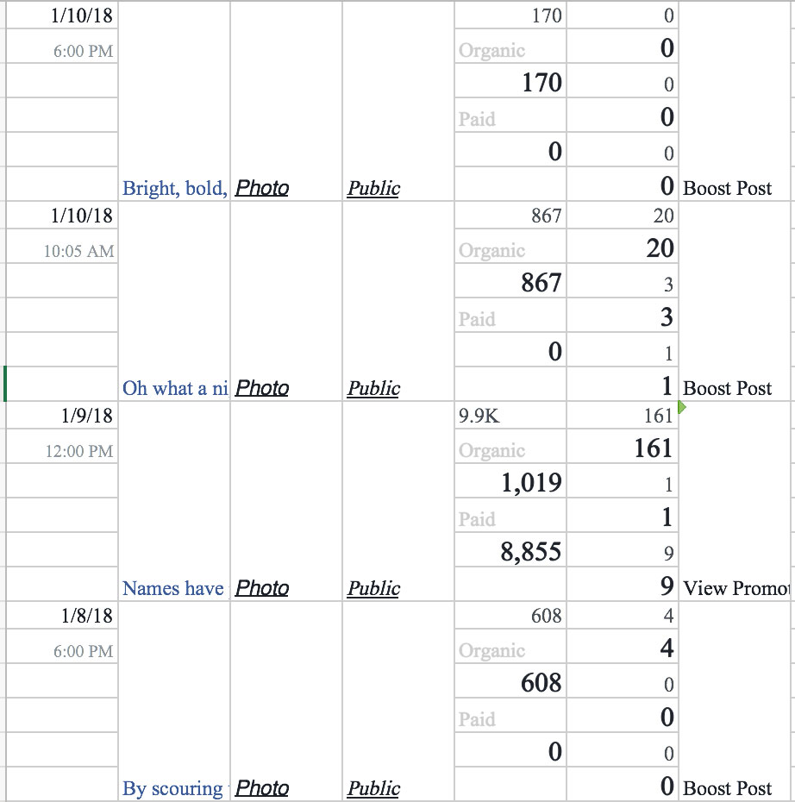
Copying and Pasting into Excel
Notes:
Cutting and pasted from the Insights page leads to this.

Slide 5
The New Way to Download Facebook Data
1.) Install Rfacebook packages.
2.) Created a stored token to be able to login to Facebook. (This is needed even to access public data.)
3.) Write the data frame to a new .CSV file.

Slide 6
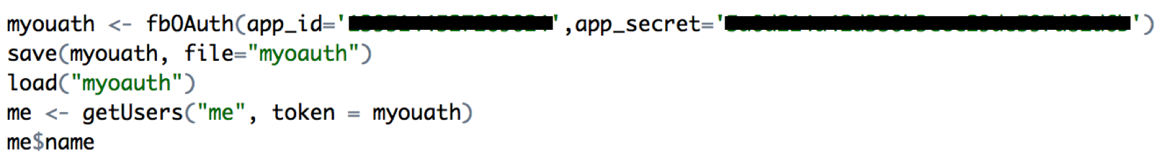
Code to Download Facebook Post Data (Part I)
How to install and access the R Facebook library.
In order to access data for either your individual Facebook account or data from a public page, a token must be used to access Facebook. This assumes you have set up your account accordingly on the Facebook Developer page.

Slide 7
Code to Download Facebook Post Data (Part II)
In order to get a view of the Facebook post data, use the getPage function and set to a table named "getpagedata.”
Write the dataset to a file on your local machine.
Which yields the following output…

Slide 9
Parsing Time Using Parsedata Package (Part I)
Install parsedate package to parse date and time in created_time column.
Goal is to group posts by hour from the time.

Slide 10
Parsing Time Using Parsedata Package (Part II)
Adjust the columns and created a time-adjusted timestamp. To adjust the timestamp, you have to add or subtract seconds, as the timestamp is based on the seconds elapsed since 1970.

Slide 12
What Times Yield the Most Post Engagement? (Excel)

Slide 13
Plotting Using ggplot
Plot average of total engagements column for each post hour.
Plots a function on y-axis to calculate mean

Slide 14
Plot from R – They Match!
Post Hours Resulting in Highest Volume of Engagement
1.) 5pm
2.) 2pm
3.) 7pm

Slide 15
Practical Application
We previously based posting time on the time when the most of our audience was on Facebook. This exercise has given us additional insight into when our posts generate the most activity from our audience.

Slide 16
Fin

